Slide 1
Environmental Pollution

Slide 2
Important definitions
Biosphere:
Narrow zone that harbors life, (Water, fraction of earth crust, lower region of surrounding air).
Pollutant:
Any substance with which an ecosystem has had no prior experience, in terms of kinds or amounts, and that can accumulate to disruptive or harmful level.

Slide 3
Biological concentration:
Increasing concentration of a relatively non-degradable (stable) substance) in body tissues, beginning at low levels and moving up through those organisms that are diners ( guests), than are dined upon ( eaten) in food web.
3
2
1

Slide 4
Environmental pollution:
The introduction of undesirable changes as the constitution or quality of water , air and soil.
Pointy-source pollution:
Pollutants which enter water ways from a specific point through a pipe.
Non-Pointy source pollution:
Pollutants those which run off or seep into water ways from broad areas of land rather than entering through a discrete pipe.
Biochemical oxygen demand (BOD):
The amount of oxygen required degrading wastes.

Slide 5
Air pollution
It is the increase of concentration of gases other than oxygen or the amount of suspended particles in the air. Also it is also it is the occurrence of strange gas or rays in the air.

Slide 6
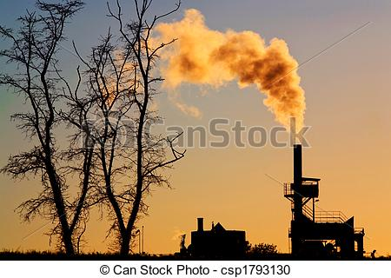
Sources of air pollution

Slide 7
Sources of air pollutants
Stationary combustion Sources:
Burning of fuel ( Coal- Petroleum- Natural gas) has been used extensively to generate power.
Complete burning of coal and petroleum oil form CO2, SO2, NO2, other products.
Coal also contains incombustible minerals and when it burns some of minerals ash flies out of chimney and the smoke produced called fly ash.

Slide 8
SO2 most significant air pollutant. It may oxidize +H2O2 H2SO4
Acid rains that is harmful to living tissues and it corrodes metals and buildings.
NO2 causes browning of building.
Incomplete combustion of Fuel
produces CO (A very toxic gas).

Slide 9
B. Mobile combustion sources
The main sources of the energy for mobile sources are: Gasoline – Diesel- Jet fuel.
They are not fitted with air pollution control equipment as in Stationary power plant.
Why?
They using refined fuel
Smaller in Size

Slide 10
The exhaust gases may contain heavy metals as lead zinc, etc.
Many products of the mobile combustion may react in the environment to produce additional pollutant.
Photochemical smog:
NO2
Hydrocarbons
Ozone
UV In Sun Light
Peroxyacetyl-Nitrate ( PAN)

Slide 11
These smog are occurred in atmosphere of sunny cities with heavy traffic.
PAN and Ozone cause eye watering, respiratory stress in addition they are extremely toxic to plants.
PAN affects photosynthesis.

Slide 12
C. Radiation
Radiation and radioactive materials are significant pollutants of the air.
Explosion and testing of nuclear weapons has added radioactivity in air.
Development of Nuclear reactors for peaceful uses has added the volumes of radioactive wastes in the air.
Radioactive isotopes used in medicine and scientific research have also another source of air radiation pollution.
These radiations harmfully affect ecosystem.

Slide 13
D. Pesticides
Various pesticides have been released into the air as spray dust and granules.

Slide 14
Effect of air pollution on climate
Air pollutants, such as dust, smoke, at higher concentration reflect solar radiation again from the atmosphere back to the earth.
Green House Effect
This condition have serious effect on earth climate as it cause Global warming followed by melting of glaciers and a flooding of the coastal cities.

Slide 15
Fig. Green house effect

Slide 16
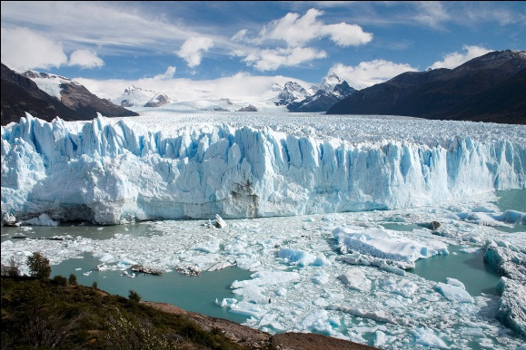
Melting of glaciers

Slide 17
Depletion of ozone layer:
The sun light wavelengths range infrared –visible –Ultraviolet.
UV colors the skin, heavier doses can cause burns and can increase the chances of skin cancer.
If more UV were to penetrate to the earth, the risk of such damage would be increased.
UV is removed by ozone layer in the upper atmosphere.
Ozone layer protects the earth from UV radiation

Slide 18
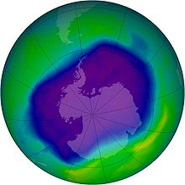
Fig. NASA Photo showing O3 depletion over the Antarctica

Slide 19
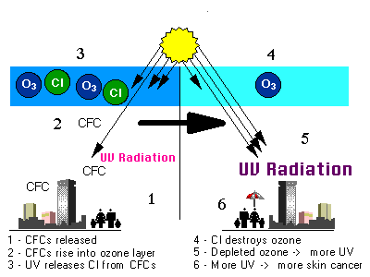
Ozone layer depletion

Slide 20
5. Some air pollutants are thinning out the protective ozone layer. Of these compounds chloroflouromethane ( CFCL3, CF2CL2).
CFCl3 used as propelent in aerosol cans
CF2Cl2(freon) is a refrigerant. They reach the air when old refrigerant rust away.
6.The exhaust of jet air craft, particularly the super-sonic, and rockets could cause destruction of ozone layer.

Slide 21
These compounds remove ozone layer allowing larger amounts of UV to reach the earth.
If these compounds are not kept under control, Ozone layer may be reduced by more than 20% over the next 50 years

Slide 22
Evaluations?
What is the photochemical smog?
List the different sources of air pollutants?
Mention the difference between stationary and mobile combustion sources.
What is the greenhouse effect, mention its impact on ecosystem.
Discuss the causes of Ozone layer Depletion and its impacts.
Choose the correct answer:
The main sources of energy for mobile engines, are
a-gasoline only
B- diesel fuel and jet fuel only.
c. gasoline, diesel fuel and jet fuel only.
d. Charcoal, petroleum oil only

